Slide 1
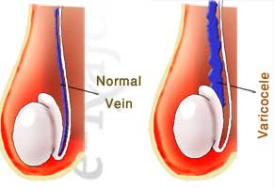
Infertility: No baby after unprotected sex for > 1 year
Incidence: Affects about 10 – 15% of reproductive age couples
Female
Male
Male & Female
40 – 50 % b/c of female disorders
1. Tubal Obstruction:
Pelvic Inflammatory disease (PID)
Endometriosis
Scaring of fallopian tubes
2. Ovulation Problems (hormone)
Polycystic Ovary Syndrome PCOS
Hypogonadotropic
3. Comorbidities:
thyroid disorder
30 – 40 % is b/c of male
Chronic Illness
Varicocele obstruction
1. Age
2. Lifestyle (diet, obesity)
3. Toxic habits (smoking, alcohol)
4. Emotion stress

Slide 2
Diagnosis General
1. History
Sexual Habits
social Hx, family Hx
Reproductive history
Gynecologic history (STD)
2. Physical Exam
BMI: obesity and anorexic
Congenital abnormalities
hyperandrogenism
Diagnosis: Tests
3. Ovarian Function test: Assess ovulation
Urinary LH
FSH
Estradiol
Body temp
4. Transvaginal Ultrasound Test
Fibroids: a benign tumor
Polyps: abnormal tissue
abnormal endometrium
5. Hysterosalpingography Test
http://www.youtube.com/watch?v=Hhvhq-oXNfM
6. Laparoscopy: incision in pelvis. a probe with a camera is inserted to inspect an organ in the abdomen (in this case the ovaries)
7. If men then semen analysis

Slide 3
Definitions
Gonadotropins: protein hormones secreted by the pituitary gland of vertebrates.
Gonadotropins include
1. FSH : follicle stimulating hormone stimulates follicle
2. LH : Luteinizing hormone stimulates ovulation
3. hCG : human chorionic gonadotropins only in humans
4. eCG : equine chorionic gonadotropins in pregnant mares (horse)
5. CG: chorionic gonadotropins in vertebrates
Hypogonadism: When the sex glands (testes or ovaries) produce little or no hormones.
Hypogonadotropic hypogonadism: a type of hypogonadism that is due to a problem with the hypothalamus gland and or pituitary gland. Low LH and FSH = no ovulation and little follicle growth
Polycystic Ovarian Syndrome (PCOS): enlarged and containing numerous small cysts located along the outer edge of each ovary (polycystic appearance)

Slide 4
Estrogen and Progesterone causes a negative feedback loop to Hypothalamus and Pit (red lines)
Green = drugs
-
Hypothalamus
-
Goal: increase LH and FSH
GnRH
-
Anterior
Pituitary
-
Gonadotropins
LH & FSH
Insulin Sensitizers
hCG (LH)
Clomiphene
Ovary
contains
Follicle
Corpus Luteum
Aromatase
inhibitors
Estradiol
Progesterone
Conclusion: this picture looks like a envelope
Notes:
1. Clomiphene Citrate: Estradiol antagonist → low estrogen causes feedback to hypo and pit → hypo and pit increases GnRH, LH and FSH increasing follicle growth
2. Gonadotropins: combination of LH and FSH
3. hCG: LH derived from pregnant female
4. Insulin Sensitizers (Metformin): decrease FSH and exaggerate premature LH pulse → use in patients that have trouble ovulating (polycystic ovarian syndrome)
5. Aromatase inhibitors: inhibit aromatase, an enzyme that converts androgens to estradiol and estrone. Reduced estradiol will cause a negative feedback to the hypo and pit, increasing GnRH, LH and FSH. Increased FSH will help the follicle grow and LH will help with ovulation.

Slide 5
Hormones:
GnRH increases release of LH and FSH
FSH: triggers follicle growth
LH: triggers ovulation
Drug MOA
Clomiphene Citrate: (SERM) Estradiol antagonist
- low estrogen causes feedback to hypothalamus and pituitary
- low estrogen to hypo and pit causes an increase GnRH, LH and FSH
- increase in GnRH, LH and FSH hormones promote pregnancy
2. Gonadotropins: combination of LH and FSH
3. hCG: LH derived from pregnant female
4. Insulin Sensitizers (Metformin):
decrease hepatic glucose production
increase menstrual cyclicity
decrease androgen levels
5. Aromatase inhibitors: inhibit aromatase, an enzyme that converts androgens to estradiol and estrone.
- low estrogen causes feedback to hypothalamus and pituitary
- low estrogen to hypo and pit causes an increase GnRH, LH and FSH
- increase in GnRH, LH and FSH hormones promote pregnancy
Notes:
-Fene = SERM
Clomiphene climb to the top = hypothalamus and pit

Slide 6
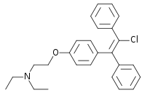
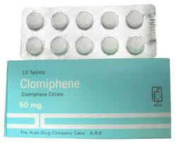
Clomiphene Citrate (SERM)
DOC for hypogonadotrophic hypogonadism
MOA: Selective Estrogen receptor antagonist
Why clomiphene is DOC for hypogonadotropic hypogonadism: Hypogonadotropic hypogonadism means the hypothalamus or pituitary produces little GnRH, LH and FSH. By antagonizing the Estrogen receptor, the body thinks that it’s not getting enough estrogen. The “low estrogen” causes a stronger negative feedback loop to the hypothalamus and pituitary, increasing its production of GnRH, LH and FSH. Increase in GnRH, LH and FSH stimulates normal follicular development
Dosing
Clomiphene Citrate 25 – 50 mg daily for 5 days. Start on day 5 of cycle
1st day is the mensus
If no ovulation occurs: increase dose by 50 mg (max dose 150 – 200 mg)
If still no ovulation then consider another regimen
Side effects:
Hot flashes, GI, Mood changes, HA, Breast discomfort
Pregnancy Category X: b/c it makes estrogen, LH and FSH wacked out
Monitor: Estrogen levels, follicular ultrasound, luteal progesterone levels
Notes:
Definitions
- Hypogonadism: When the sex glands (testes or ovaries) produce little or no hormones.
Hypogonadotropic hypogonadism: a type of hypogonadism that is due to a problem with the hypothalamus gland and or pituitary gland. Low LH and FSH = no ovulation and little follicle growth
Clomiphene climb to the top = hypothalamus and pit
Climb with 50 fingers for 5 days

Slide 7
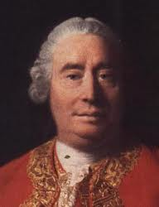
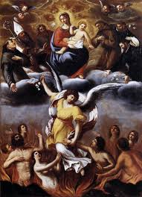

Gonadotropins: use if Clomiphene fails
Use: in patients with hypogonadism
Side Effects:
Ovarian Hyperstimulation syndrome: Drug side effect that causes ovaries become enlarged with fluid. During ovulation, fluid might leak into the GI.
Monitor: FSH, LH, estradiol and ultrasound tests
Hume-gone
Pergo-gone
Repo-next
Type | Rx | LH | FSH
hMG Human menopausal gonadotropin | Humegon | Y | Y
hMG | Pergonal | Y | Y
hMG | Repronex | Y | Y
Highly purified follicle stimulating hormone | Fertinex |  | Y
Urofollitropin (recombinant FSH) | Follistim | Some | Y
Urofollitropin (recombinant FSH) | Gonal F | Some | Y
Notes:
Definition:
Gonadotropins: protein hormones secreted by the pituitary gland of vertebrates.
Gonadotropins include
1. FSH : follicle stimulating hormone stimulates follicle
2. LH : Luteinizing hormone stimulates ovulation
3. hCG : human chorionic gonadotropins only in humans
4. eCG : equine chorionic gonadotropins in pregnant mares (horse)
5. CG: chorionic gonadotropins in vertebrates
Hume is GONE (gonadotropin), pergotory is next, repo is next

Slide 8
Human Chorionic Gonadotropin (hCG)
MOA: Gonadotropins in general stimulate ovulation by stimulating LH surge
Source: obtained form urine of pregnant women
Drug | Dose
Pregnyl | When follicle > 16 mm in diamter 5000 – 10,000 Units IM x1 Or 250 mcg SQ Ovulation will occur 24 – 36 hours after administration
Novarel | “ “
Ovidrel | “ “
Profasi | “ “
Story of Humans
Nova-Rel, Ovid-Rel, Preg-ILL
Notes:
The story of humans: ren left brian for tyler
Never tell ovid ren she’s pregnant ill
Nova Tell, Ovid ReL she’s Preg ILL
Nova tell
Ovid rel
Pregn ill

Slide 9
Insulin Sensitizers: Metformin
Use: Polycystic Ovarian Syndrome (PCOS)
PCOS is the leading cause of anovulatory infertility
# | Patho of PCOS | Symptom | MOA of Metformin
1 | Decreased FSH | No follicle growth = no fertility | Increase menstrual cyclicity
2 | Premature LH pulse | No ovulation | Increase menstrual cyclicity
3 | Increase androgen production | Hirsutism, acne, alopecia | Decrease androgen levels
4 | Defect in insulin action | Insulin resistance Impaired glucose tolerance DM2 obesity | Decrease hepatic glucose production
Drug: Metformin
MOA: in table
Dose: 500 – 2500 mg daily
Notes:
PCOS: enlarged and containing numerous small cysts located along the outer edge of each ovary (polycystic appearance)

Slide 10
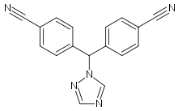
Aromatase Inhibitors
Use: Polycystic Ovarian Syndrome (PCOS)
MOA:
1. inhibits aromatase enzyme that converts androgens to estrogens (estradiol and estrone) 2. decrease in estrogen causes negative feedback
3. you the get story…
Pros: Do not deplete receptors or produce a negative effect on endometrium
Side Effects b/c low estrogen
hot flashes
Vasodilation and HTN? wtf?
HA
mood changes, depression
osteoporosis (b/c low estrogen)
← triazole
Generic | Brand | Dose
LeTROZOLE | Femara | 2.5 – 7.5 mg PO daily for 5 days
AnasTROZOLE | Arimidex | 2.5 mg PO daily for 5 days
Notes:
Trolling in circles???
PCOS: enlarged and containing numerous small cysts located along the outer edge of each ovary (polycystic appearance)

Slide 11
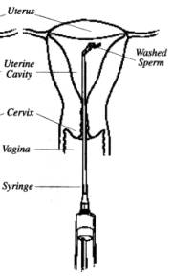
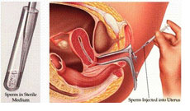
Intrauterine Insemination (IUI)
Use: when the dude can’t follow through. When mild male factor or cervical factor infertility is diagnosed
Method: when female ovulates, semen is pumped into the vagina
Assisted Reproductive Technology (ART)
ART: generally the process of intercourse is bypassed either by insemination (for example, artificial insemination) or fertilization of the oocytes in the laboratory environment (i.e., in vitro fertilization).

Slide 12
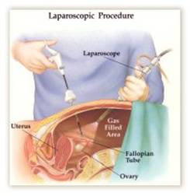
Non-Pharmacologic Treatment
If obese then diet and exercise
If abnormal tubules then reconstruct tubes
If fibroids, polyps, scar tissue then remove fibroids, polyps and scar tissue
If endometriomas then Laparoscopy (picture)
Endometriomas usually present as a pelvic mass arising from growth of ectopic endometrial tissue within the ovary. They typically contain thick brown tar-like fluid (hence the name "chocolate cyst") and are often densely adherent to surrounding structures, such as the peritoneum, fallopian tubes, and bowel. An endometrioma may be associated with symptoms of endometriosis (eg, pelvic pain, dysmenorrhea, and dyspareunia) or identified at the time of evaluation for a pelvic mass or infertility. A woman with a ruptured endometrioma may initially present with peritoneal signs and symptoms, elevated white blood cell count, and low grade fever, similar to patients with acute pelvic inflammatory disease or appendicitis.

